Slide 1
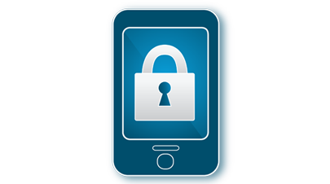
Mobile Security
Vaibhav Purohit

Slide 2
Introduction
Mobile Security is the term for protection of smartphones, laptops and other portable computing devices and their networks, from threats associated with wireless computing

Slide 3
Agenda
What is Mobile Security
Major concerns
Why Mobile Security
Security loopholes
Various measures
Effectiveness
Advantages
Drawbacks
Current Scenario
Conclusion

Slide 4
What is Mobile Security
Mobile Device Management System
Services or products for organization related security
Designed as per requirements
Antivirus
Application for general use
No in depth security

Slide 5
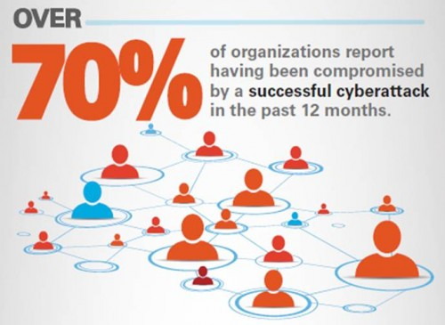
Major Concerns
Device loss & theft
Application Security
Device data leakage
Malware attacks
Graynet applications
Juice Jacking

Slide 6
Why Mobile Security
Increased device operation
Major Business shift to devices
Increased Internet Exposure
Employee based device use
Increasing CyberCrime ($110 billion in 2011)
Smart Malware

Slide 7
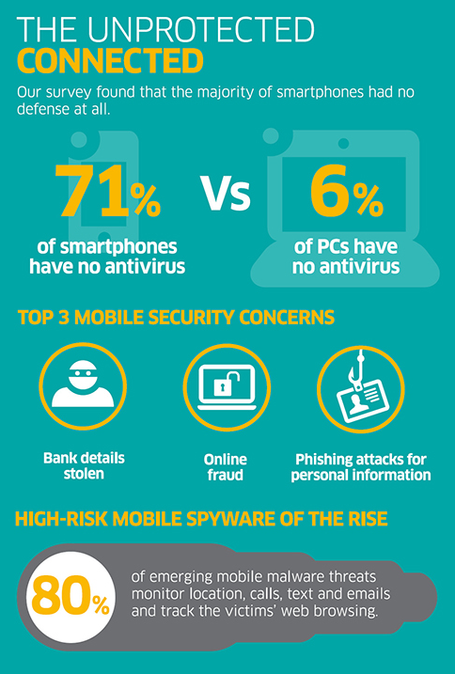

Slide 8
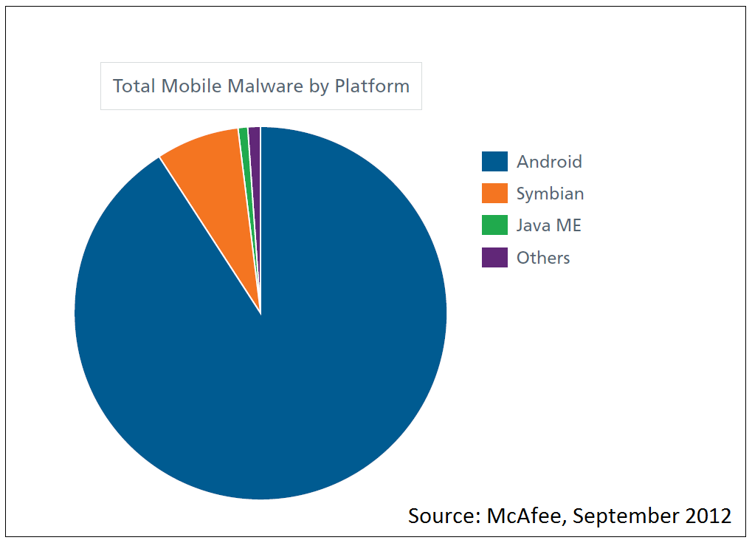
Smart Malware
Use of Encryption
Port Agility
JavaScript Highjacking

Slide 9


JavaScript Highjacking
AJAX (Asynchronous JavaScript and XML files)
Interactive Web Applications

Slide 10
Various measures
Bring Your Own Concept
Data Encryption
Sandboxing
Initializing Vectors
Nonce (Numbers Used Once)
OTP
Web Application Firewall
Antivirus

Slide 11
Bring Your Own Concept
Bring Your Own Network(BYON)
Bring Your Own Device(BYOD)
Bring Your Own Technology(BYOT)

Slide 12
Antivirus
VIRUS
A set of programs to perform certain operations-
Prevent the device from malwares
Detect and search for malwares
Analyze the malicious software
Remove them

Slide 13
Antivirus Expectations
Some general features are expected of an antivirus in general-
Lightweight and Cost Efficient
Scanning of files and directories
Peripheral device security
Device health status & AutoScans

Slide 14
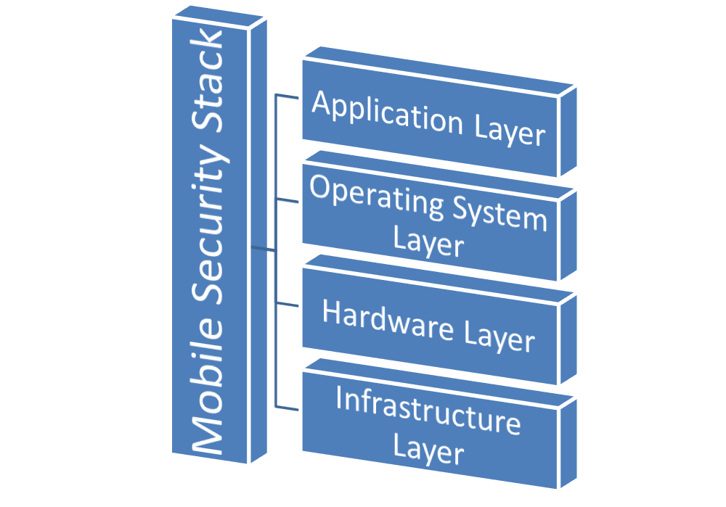
Effectiveness
ID based Cryptography
Decreased cybercrimes
Much more Secured Data
Efficiency yet to be worked on

Slide 15
Benefits
Secured Data
Enhanced Security Awareness
Reliable Network
Productivity Encouragement by employee device usage freedom
Peace of Mind

Slide 16
Drawbacks
Heavy Softwares
No good for Single Tasking Systems
High System Resource usage
Inadequate Access due OS bound restrictions
Expensive
Business Hindering Limitations

Slide 17
Current Scenario
80% of portable devices are smartphones
Smartphone OS less secure compared to laptops
Still no security measures taken for many devices

Slide 18
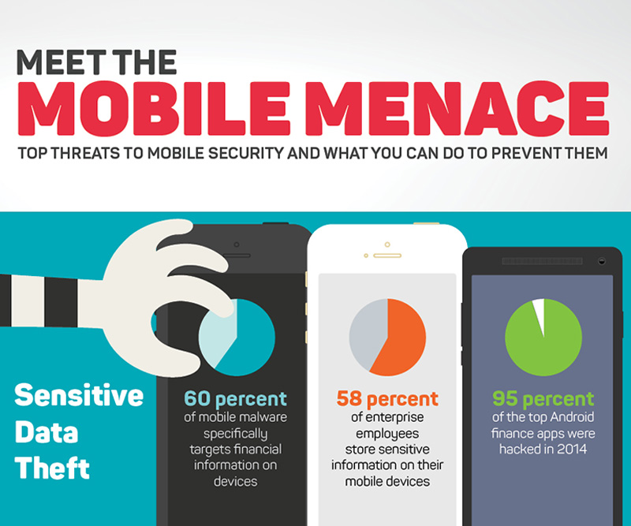

Slide 19
Apple VS Android
IOS
Geolocation feature
Auto Erase
Security available only after version 4
Less distribution channels
Android
UI Modification allowed
Almost all apps are approved
No special security measures for app store
Remote installation allowed

Slide 20
Common Features
Both the operating systems provide some common security measures-
Permission based access control
Limited hardware access
Resistance to Web based attacks
Data Encryption
Application security testing

Slide 21
Current Popular Apps
360 Security
Avast Mobile Security
TrustGo
Avira Security

Slide 22
Conclusion
Increased High-Tech Malware has expanded MS Business
Internet Based World requires Security
Cost is worth the guard
A yes for Mobile Device Management Systems

